Slide 1
DATA ANALYTICS AIRLINE DATA ANALYTICS FOR AVIATION INDUSTRY

Slide 2
TEAM MEMBERS:
SINEKA.V
VINOTHINI.P
SRUTHI.R
THARANI.E

Slide 3
PROJECT DEVELOPMENT PHASE
SPRINT 1
COLLECTING THE DATA
UPOADING THE DATA
PREPARING THE DATA
SPRINT 2
EXPLORATION OF DATA
PRESENTATION OF DATA
SPRINT 3
CREATING INTERATIVE DASHBOARD WITH EXCLUSIVE GRAPHICAL REPRESENTATION
SPRINT 4
REPORT CREATION AND STORY CREATION

Slide 4
SPRINT 3
CREATING INTERATIVE DASHBOARD

Slide 5
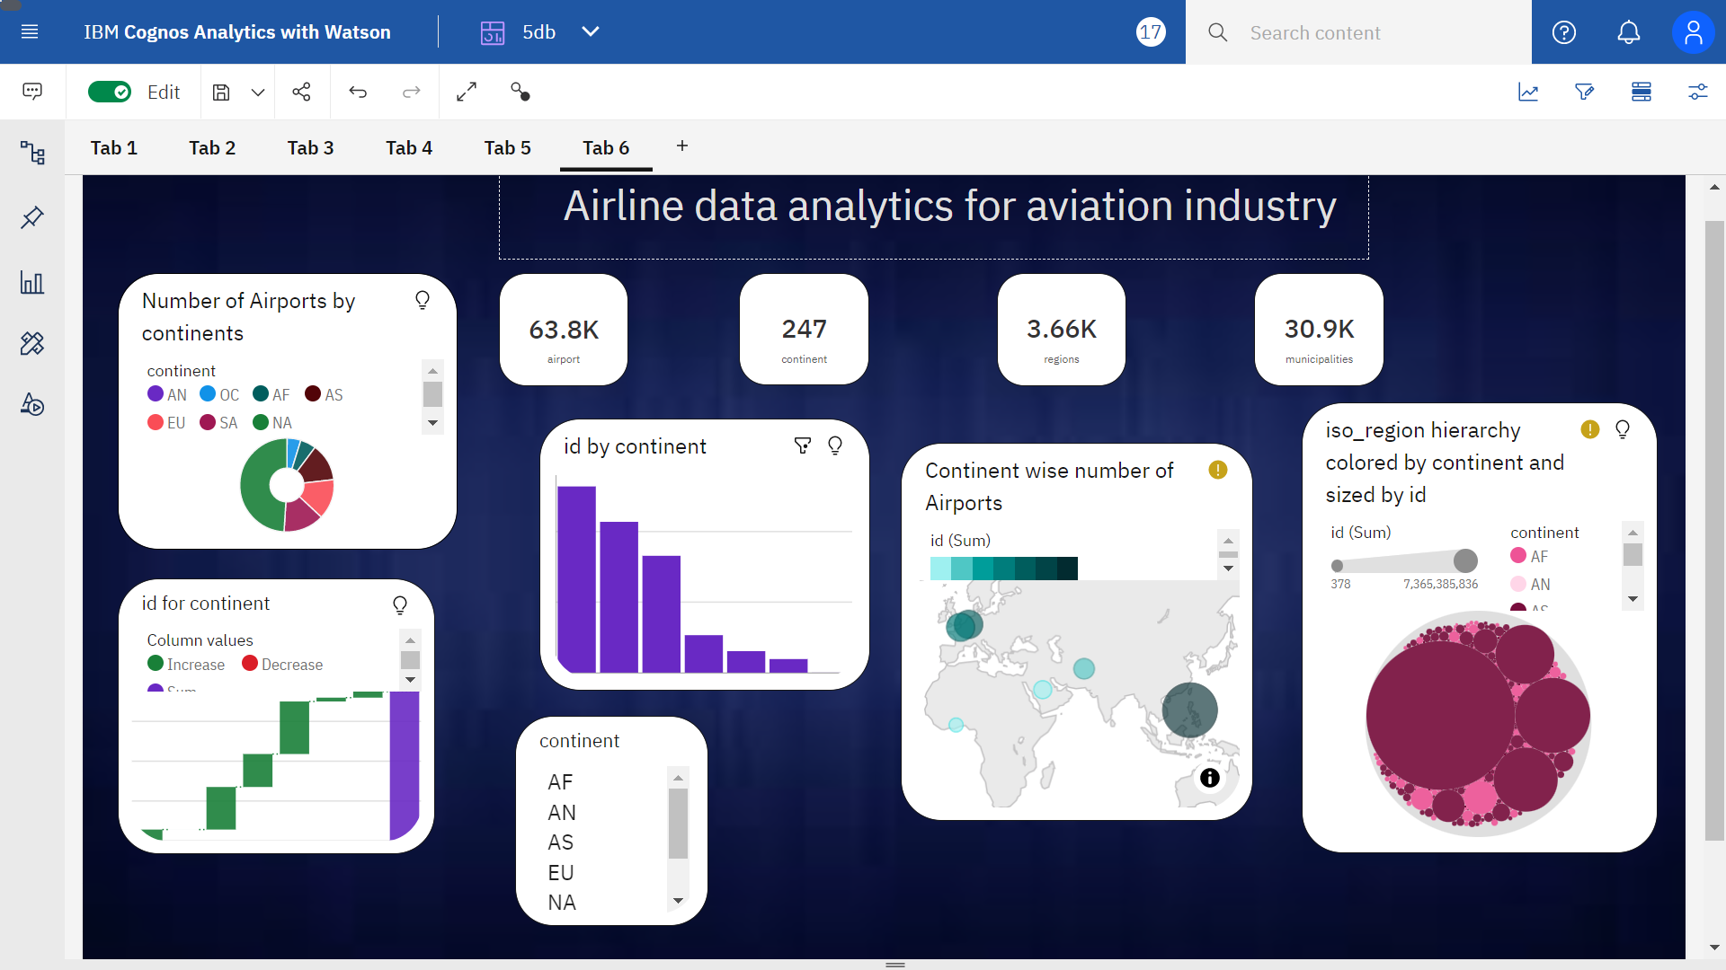

Slide 6
THANK YOU

